Slide 1
TASK-2
Finding all possible vulnerabilities and loopholes in : http://zero.webappsecurity.com/ using Netsparker

Slide 2
Title: Found Out-of-date Version (Apache) Domain: http://zero.webappsecurity.com/ Steps to reproduce : Step 1: Add http://zero.webappsecurity.com/ the dialogue box. Step 2: Define the customization option to scan as per your need Step 3: It will start scanning it automatically Impact: Since this is an old version of the Apache it may be vulnerable to attacks. Apache http server is an open source software that allows user to deploy their website on the internet . So using the out dated version of Apache can lead to various malicious attacks and information theft and loss Identified Version 2.2.6 (contains 4 critical and 65 other vulnerabilities) Latest Version 2.4.48 Vulnerability Details: Netsparker identified that http://zero.webappsecurity.com/ is using an out-of-date version of Apache. Apache, the world's widely used web server software, has been a victim of notorious vulnerabilities time and again. These vulnerabilities render the server prone to various form of malicious attacks and other internet frauds leading to information theft and loss. http://zero.webappsecurity.com/ is using 2.2.6 version of Apache which contains 4 critical and 65 other major vulnerabilities. Some Vulnerabilities like these listed below can seriously harm our user data and has potential threat to the website and server. 1.)Apache HTTP Server Insufficient Information Vulnerability modules/arch/win32/mod_isapi.c in mod_isapi in the Apache HTTP Server 2.0.37 through 2.0.63, 2.2.0 through 2.2.14, and 2.3.x before 2.3.7, when running on Windows, does not ensure that request processing is complete before calling isapi_unload for an ISAPI .dll module, which allows remote attackers to execute arbitrary code via unspecified vectors related to a crafted request, a reset packet, and "orphaned callback pointers." 2)Apache HTTP Server Improper Restriction of Operations within the Bounds of a Memory Buffer Vulnerability In Apache httpd 2.2.x before 2.2.33 and 2.4.x before 2.4.26, mod_mime can read one byte past the end of a buffer when sending a malicious Content-Type response header.

Slide 3
3)Apache HTTP Server Improper Input Validation Vulnerability In Apache httpd before 2.2.34 and 2.4.x before 2.4.27, the value placeholder in [Proxy-]Authorization headers of type 'Digest' was not initialized or reset before or between successive key=value assignments by mod_auth_digest. Providing an initial key with no '=' assignment could reflect the stale value of uninitialized pool memory used by the prior request, leading to leakage of potentially confidential information, and a segfault in other cases resulting in denial of service. 4)Apache HTTP Server Improper Authentication Vulnerability In Apache httpd 2.2.0 to 2.4.29, when generating an HTTP Digest authentication challenge, the nonce sent to prevent reply attacks was not correctly generated using a pseudo-random seed. In a cluster of servers using a common Digest authentication configuration, HTTP requests could be replayed across servers by an attacker without detection. 5)Apache HTTP Server Out-of-bounds Read Vulnerability A specially crafted HTTP request header could have crashed the Apache HTTP Server prior to version 2.4.30 due to an out of bound read while preparing data to be cached in shared memory. It could be used as a Denial of Service attack against users of mod_cache_socache. The vulnerability is considered as low risk since mod_cache_socache is not widely used, mod_cache_disk is not concerned by this vulnerability. 6)Apache HTTP Server Improper Access Control Vulnerability The Apache HTTP Server through 2.4.23 follows RFC 3875 section 4.1.18 and therefore does not protect applications from the presence of untrusted client data in the HTTP_PROXY environment variable, which might allow remote attackers to redirect an application's outbound HTTP traffic to an arbitrary proxy server via a crafted Proxy header in an HTTP request, aka an "httpoxy" issue. NOTE: the vendor states "This mitigation has been assigned the identifier CVE-2016-5387"; in other words, this is not a CVE ID for a vulnerability. 7)Apache HTTP Server Out-of-bounds Read Vulnerability A specially crafted HTTP request header could have crashed the Apache HTTP Server prior to version 2.4.30 due to an out of bound read while preparing data to be cached in shared memory. It could be used as a Denial of Service attack against users of mod_cache_socache. The vulnerability is considered as low risk since mod_cache_socache is not widely used, mod_cache_disk is not concerned by this vulnerability. Mitigations: If you want to prevent the website from being vulnerable please upgrade your installation of Apache to the latest stable version. You can do this by performing following steps 1. Check Apache Version Number 2. Backup Apache configuration 3. Install EPEL. 4.Enable EPEL Repository 5. Upgrade Apache Version 6. Restart Apache Server POC including screenshots are attached in the report.

Slide 4
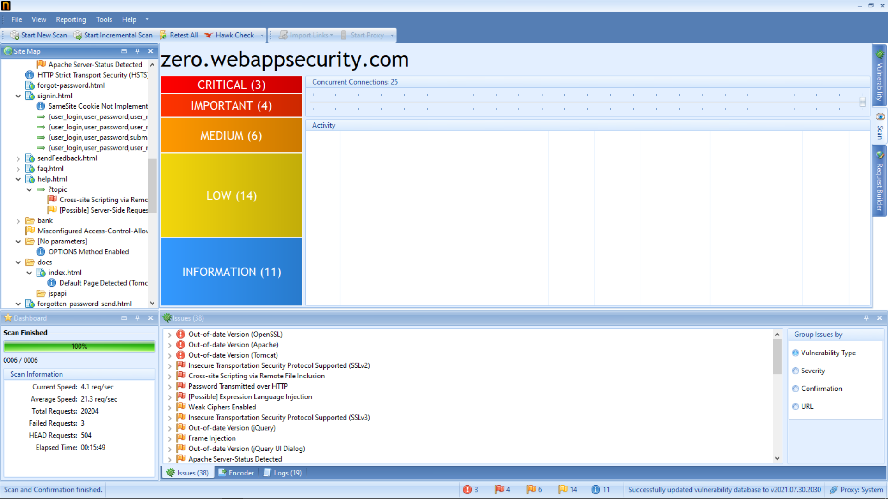
Page -1

Slide 5
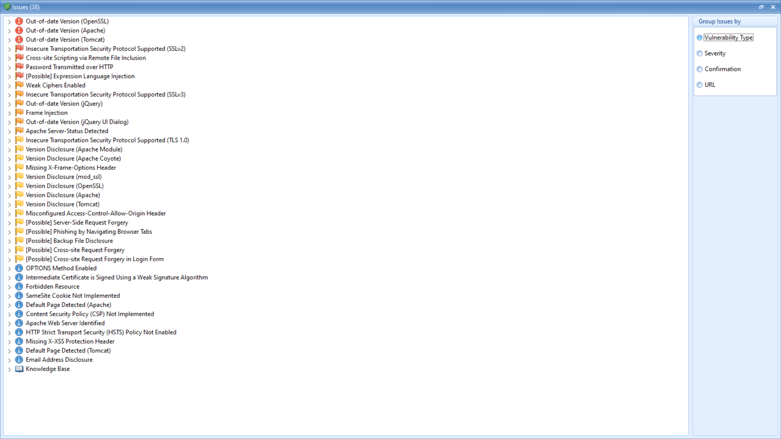

Slide 6
